Slide 2
Go to https://colab.research.google.com/

Slide 3
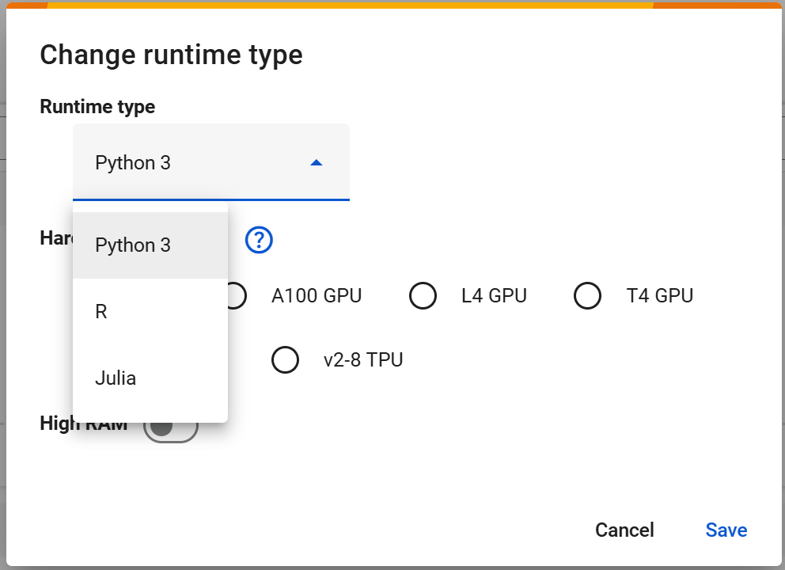

Slide 4
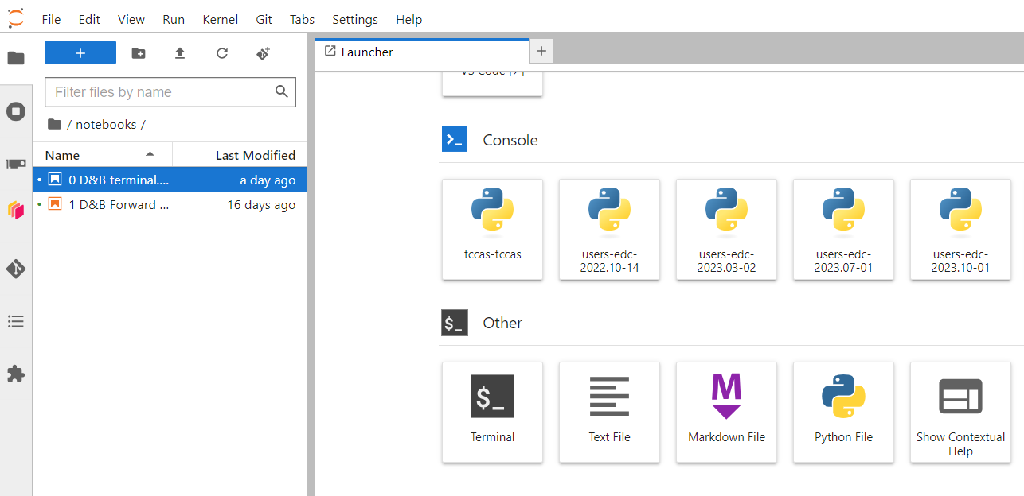
Linux bash or Jupyter Notebooks
We can also open a bash terminal
A .ipynb file is a notebook

Slide 5
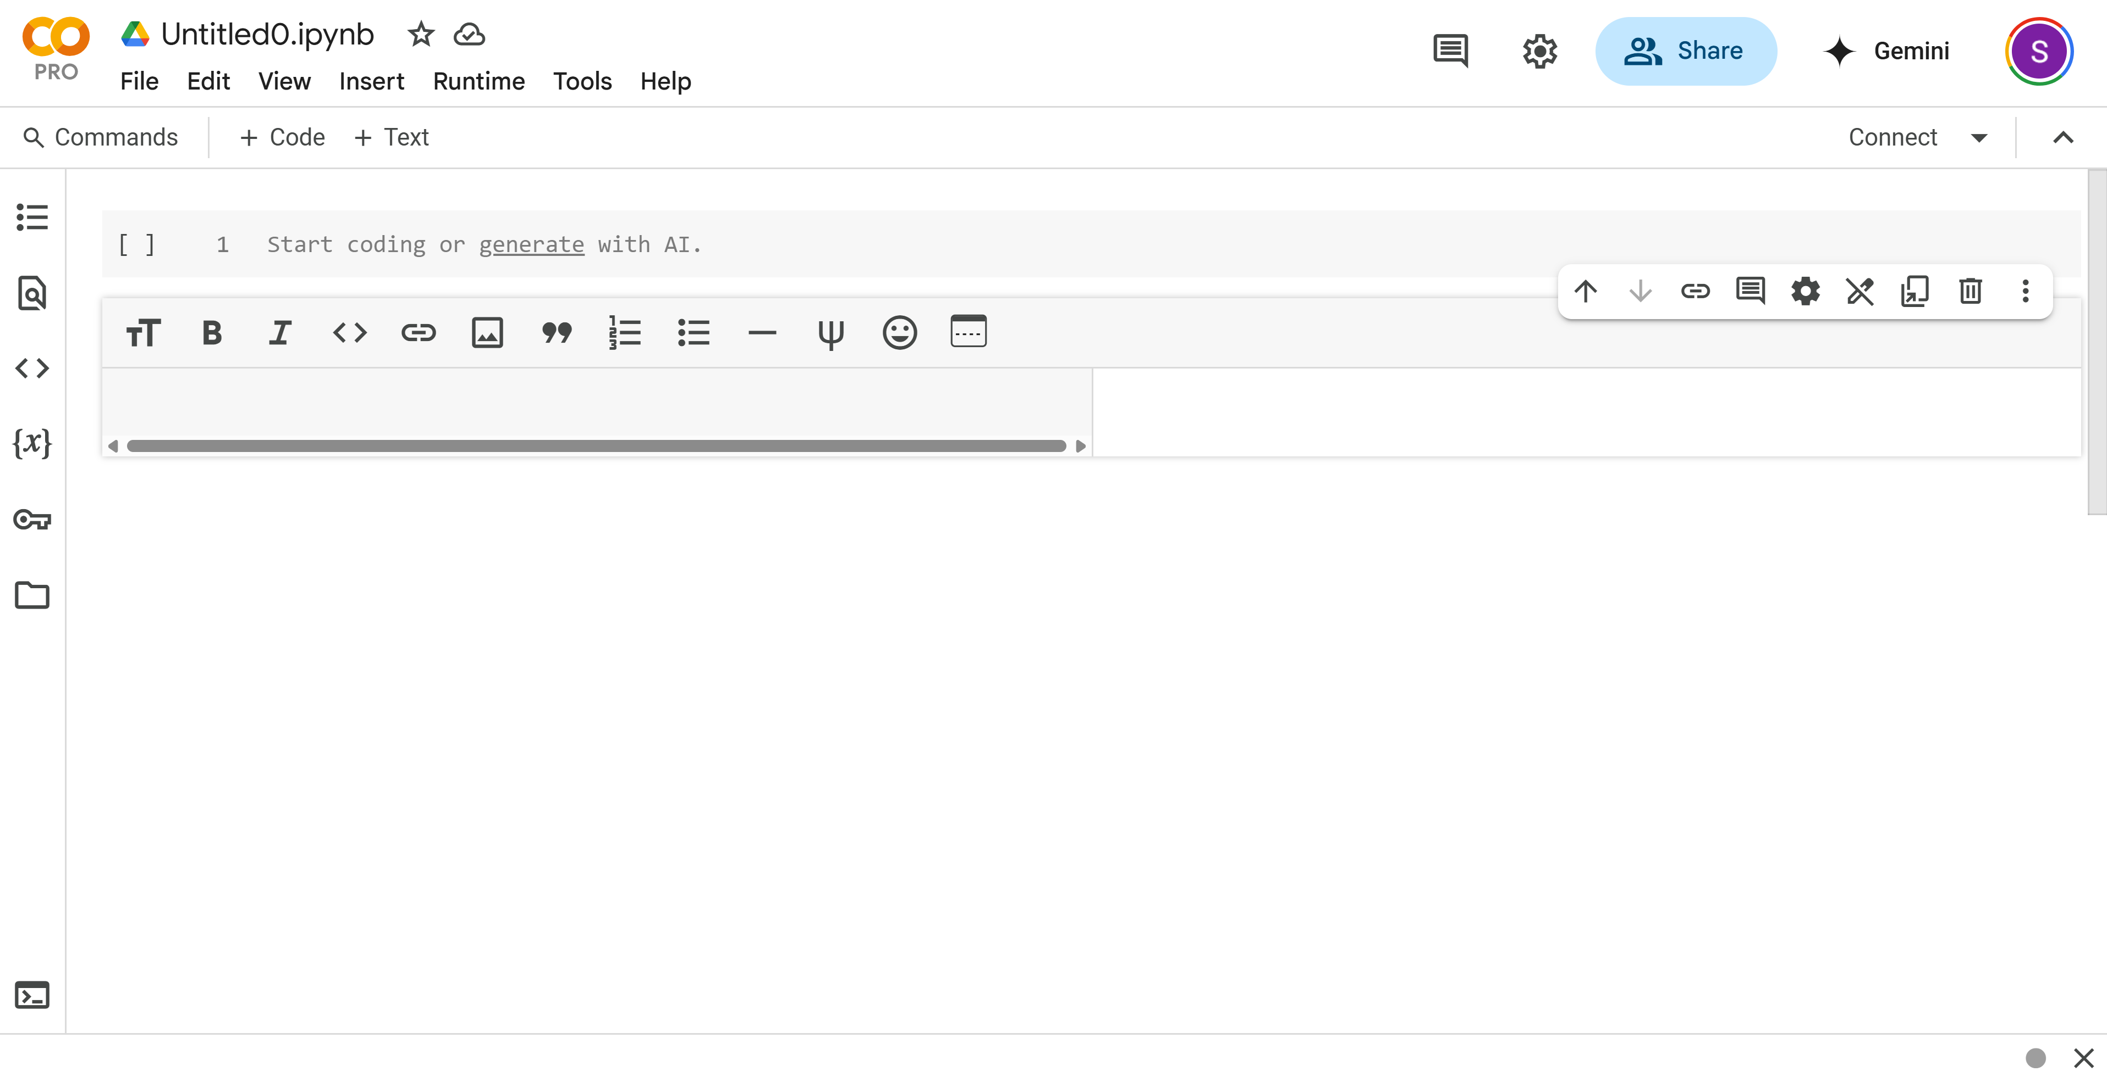
Code
Markdown text

Slide 6
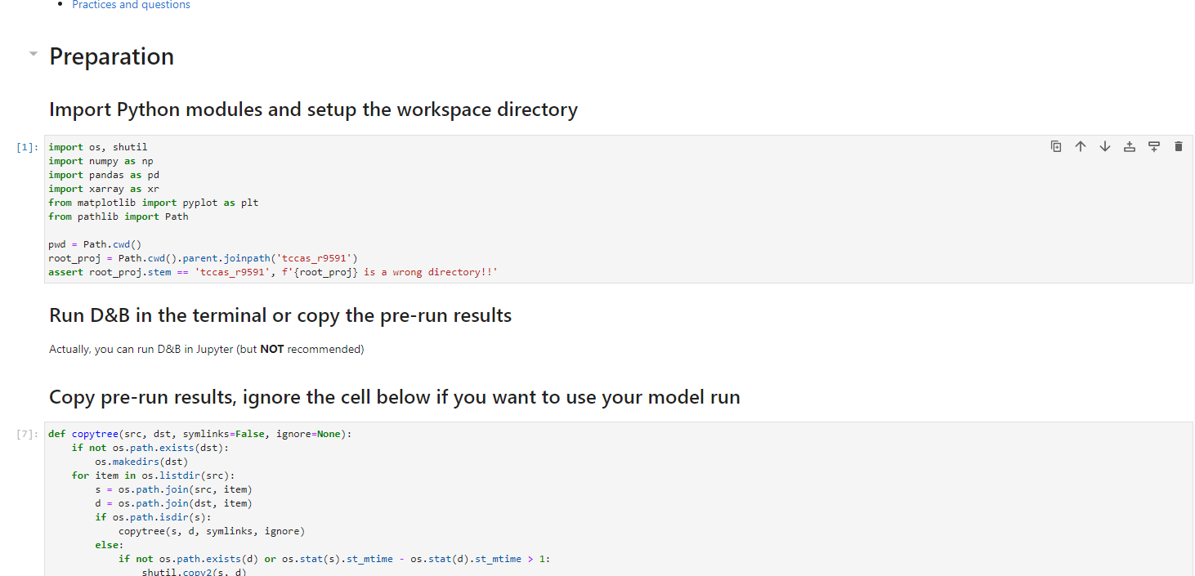
Jupyter Notebook introduction
Code cell
Text and/or Markdown cell

Slide 7
Jupyter Notebook introduction

Slide 8
Another tip

Slide 10
Linux terminal commands
Basics commands:
Advanced:
CMD | Meaning
$ | User directory
cd | Change directory
ls | List files
mkdir | Create a directory
mv | Move
rm | Remove
CMD | Meaning
/ | Root directory
pwd | Current directory
su | Switch to super/root user
sudo | Be su for one command
apt-get | Package tool
wget | Download something
find | Find something
clear | Clear screen
cp | Copy
chmod | Change permissions
source | Execute commands from a file
ssh | Secure Shell
ln | Create links
Boolean: 1 or T for True and 0 or F for False
WARNING:
THINK CAREFULLY BEFORE THIS: ‘rm -rf /*’
It deletes everything!
Don’t worry too much, you are not the root user in most cases.

Slide 11
